Slide 1

NHÓM 10 IS207.L21
https://github.com/Huynhkimphat/UiT_News
Phát Triển Ứng Dụng Web

Slide 2

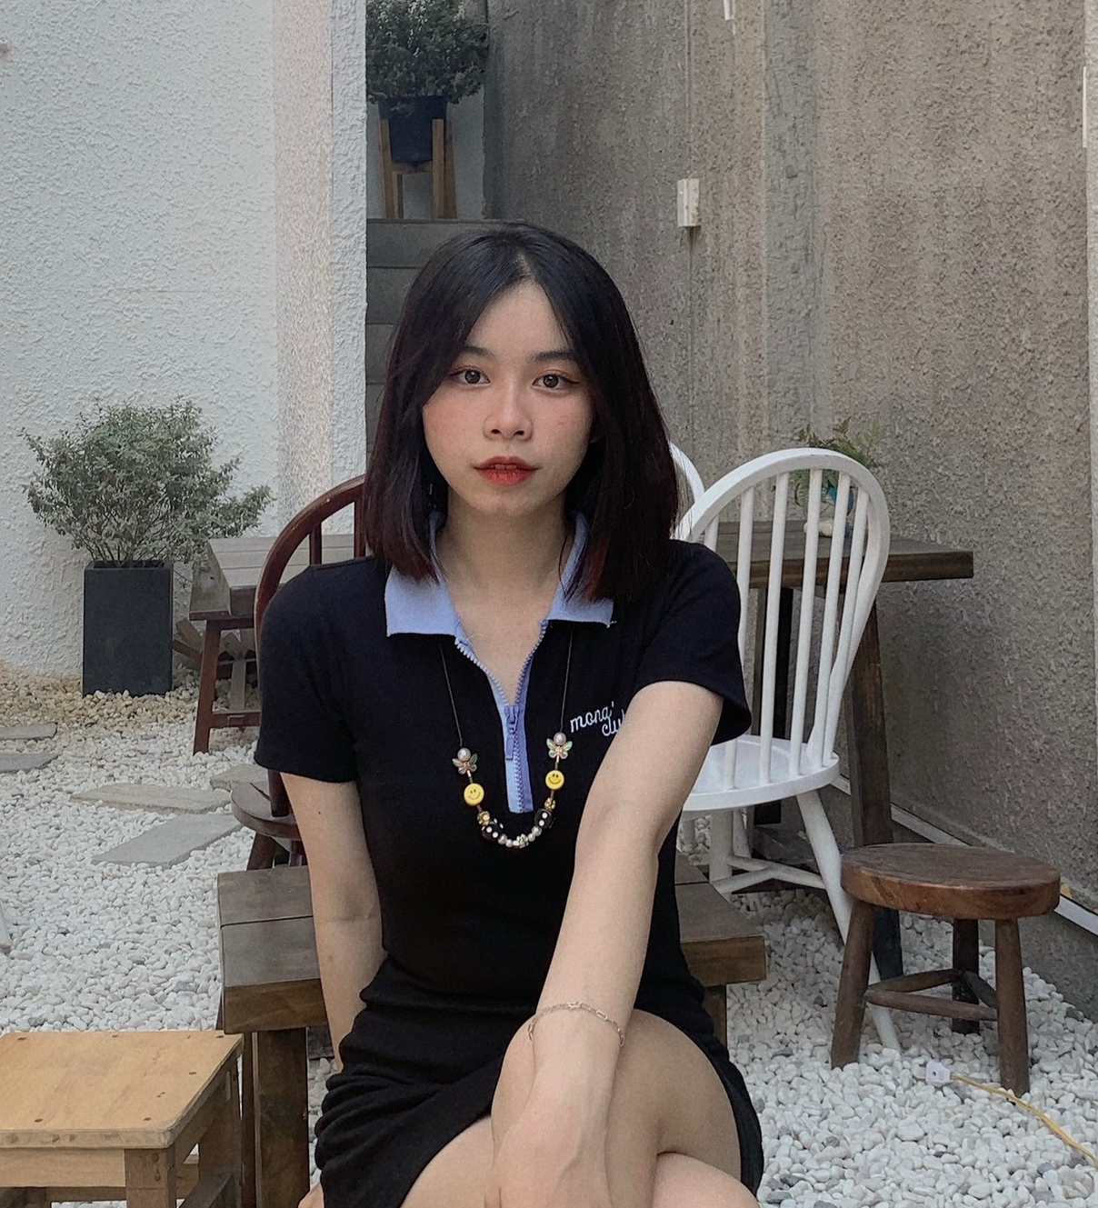
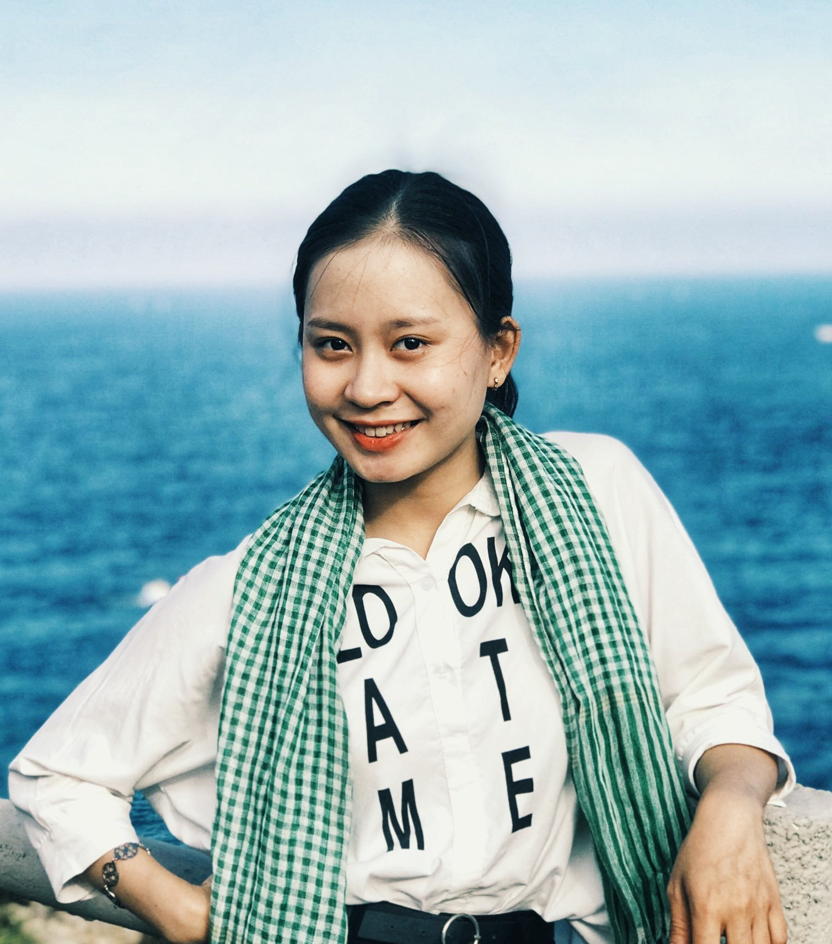
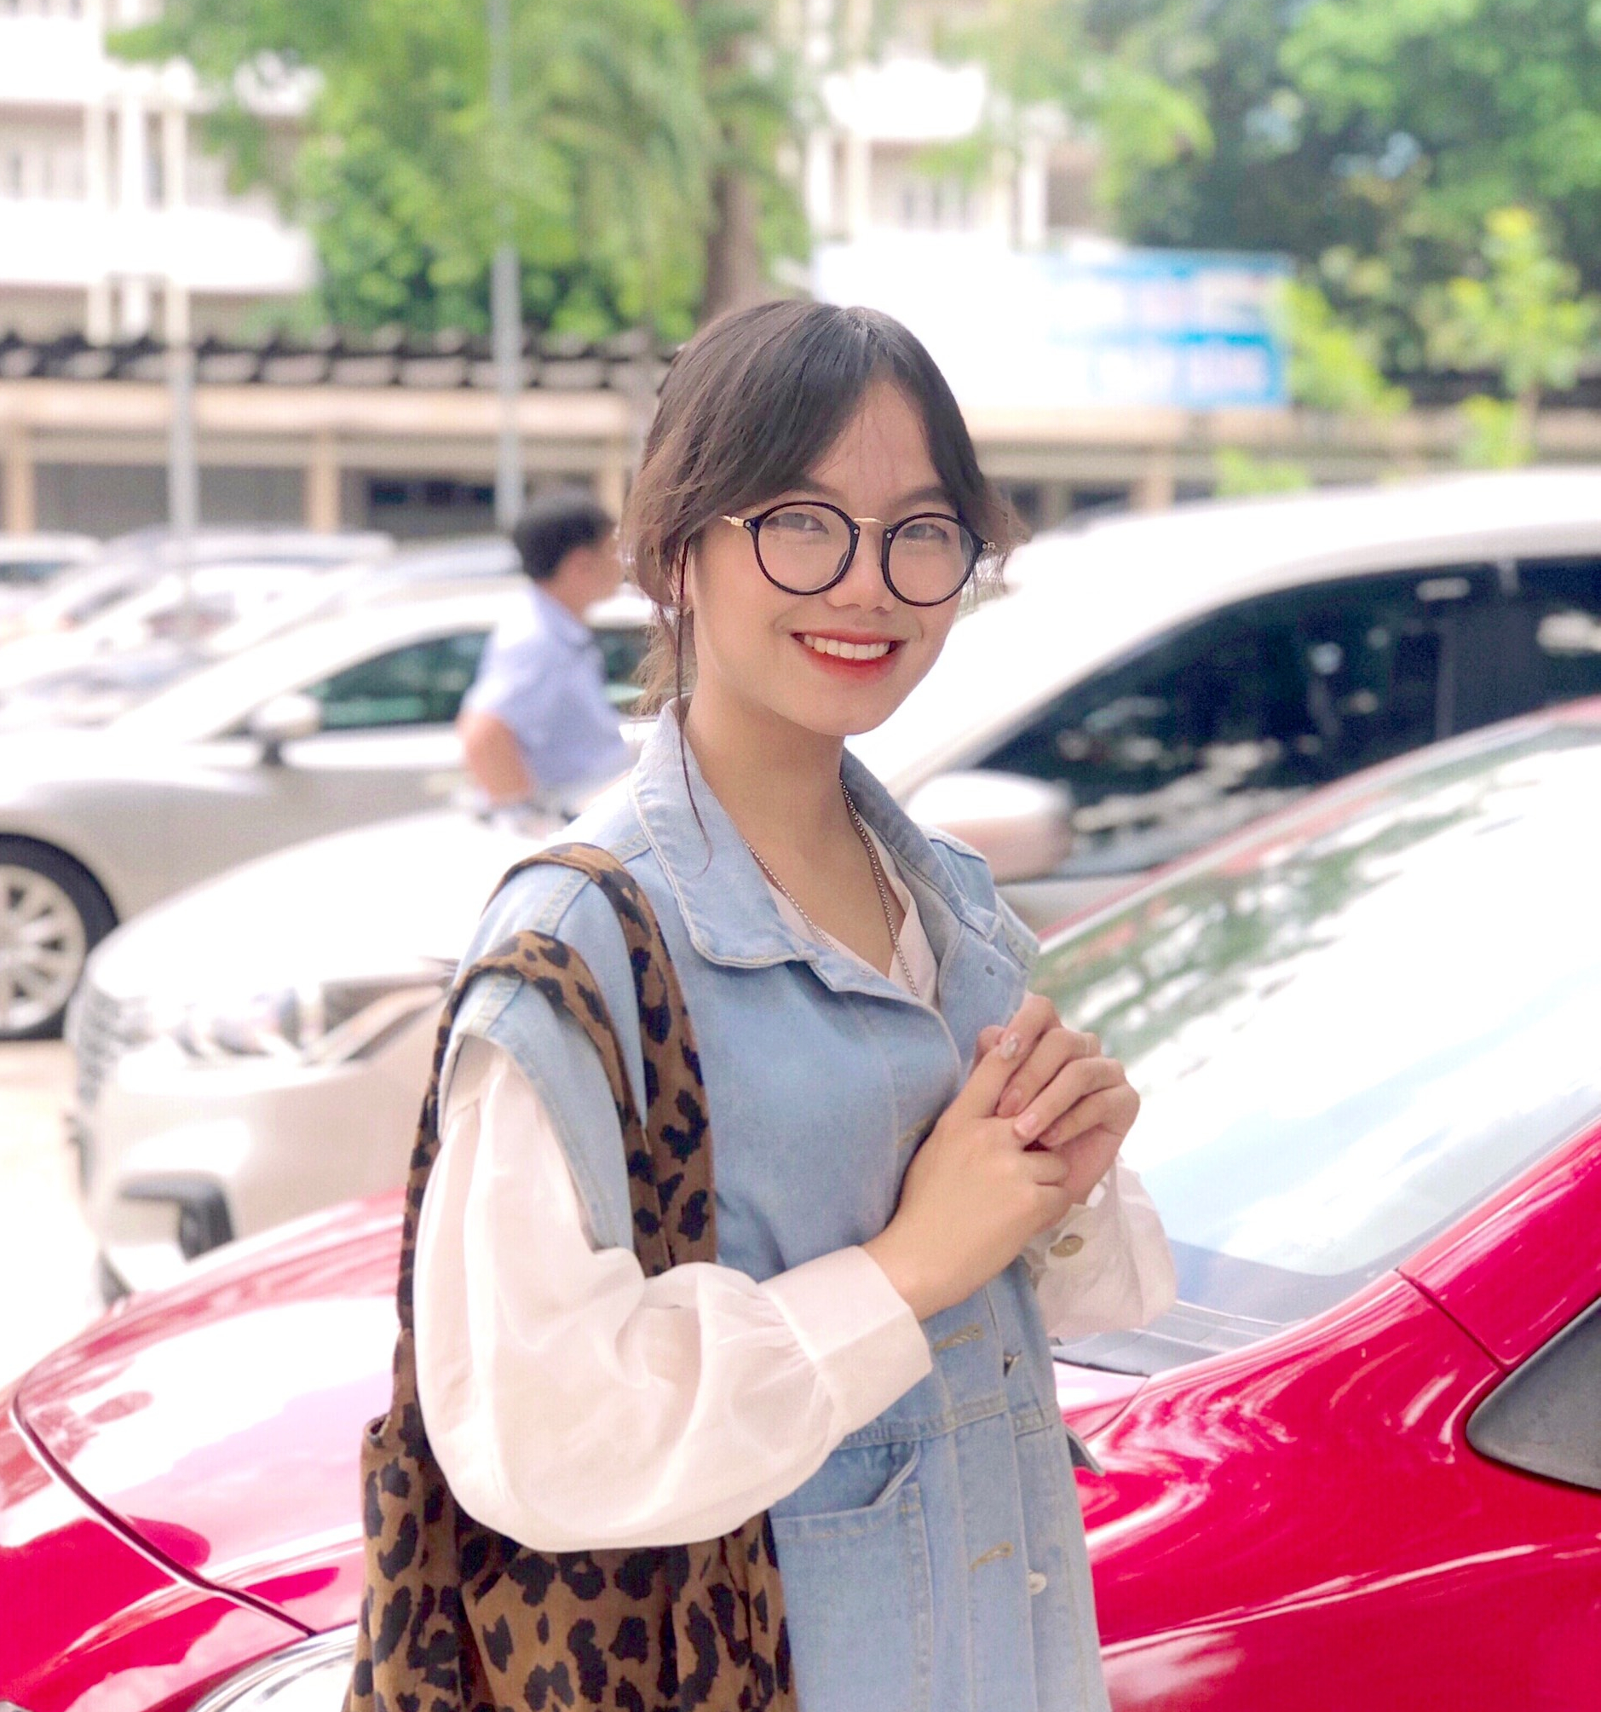
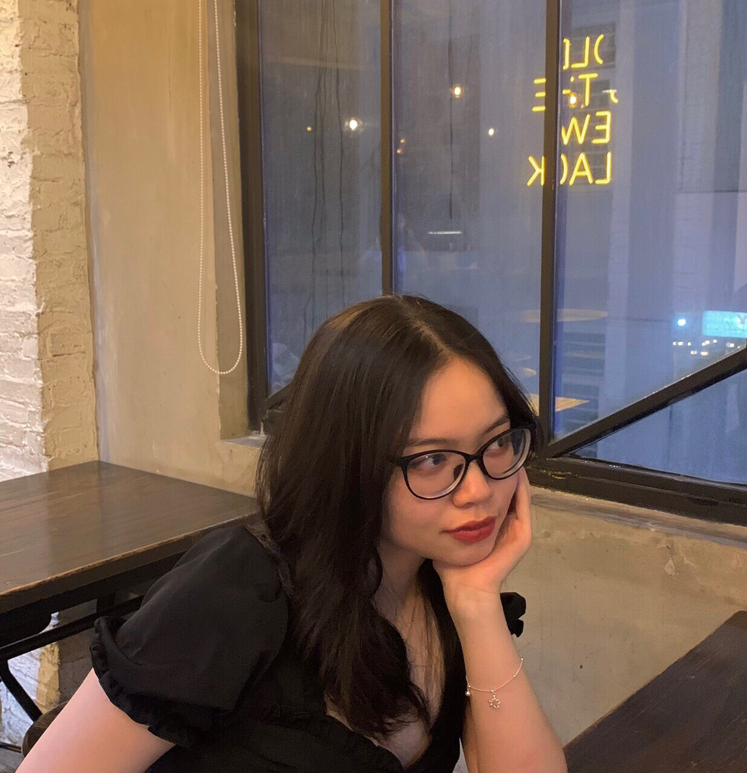
OUR TEAMS
Thuy Na
Phuong Dung
Kim Phat
19521992
LEADER
Hoang Yen
19521864
19522557
Tuong Quy
19520056
19522108

Slide 3
INTRODUCE PROJECT
Change on a daily basis, linking to stories on its own site, or on others.
Circle News, giving information on around the world, as well.
More convenient than traditional press, large information capacity, faster communication and information reception.
A browser-based interface for getting the news, with an easy way to use and access to other websites.

Slide 4
PROGRAMMING LANGUAGE
HTML
CSS
Bootstrap v5.0 JAVA SCRIPT

Slide 5
OVERALL TASKING
—Võ Nguyễn Phương Dung
—Lê Hoàng Thuỳ Na
—Huỳnh Kim Phát
—Phạm Nguyễn Hoàng Yến
—Lương Tường Quy
• Login
• Register
LEADER
• Detail
• comment
• Create/Update/Delete Post For Admin
• Account Settings
• Account Info Page
• Homepage
• Header
• Footer

Slide 6
TIMELINE
12.05
16.05
08.05
14.05
ONLINE MEETING AND WORK DISTRIBUTION
REVIEW AND EDIT CODE 2ND TIME
REVIEW AND EDIT CODE 1ST TIME
MERGE CODE AND COMPLETE

Slide 7
AUTHENTICATE
01
02
03
LOGIN
REGISTER
FORGOTPASSWORD CHECK MAIL

Slide 8
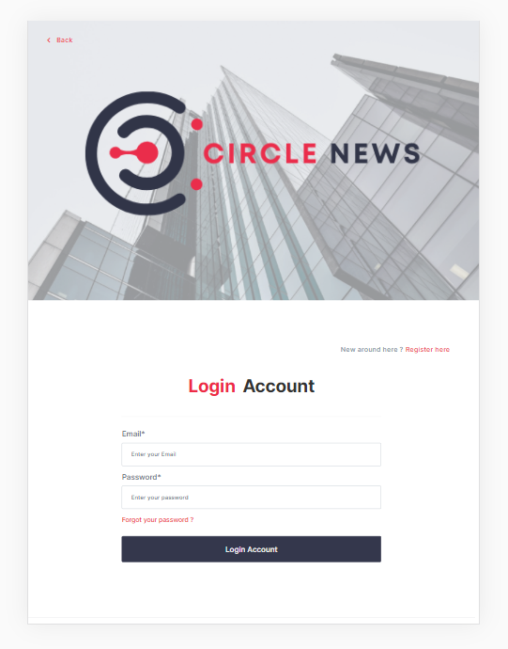
LOGIN PAGE
Validate:
All fields are required (If username/password empty
and clicked login => Notice message required)
On focus => Blur => Notice message require
Username : must be a valid email <...@....>
Password : must be higher than 6 characters
Logic:
Click Register => To Page Register
Click Forgot Password => To Page Forgot Password
Click Login Button and all validations are right => Login

Slide 9
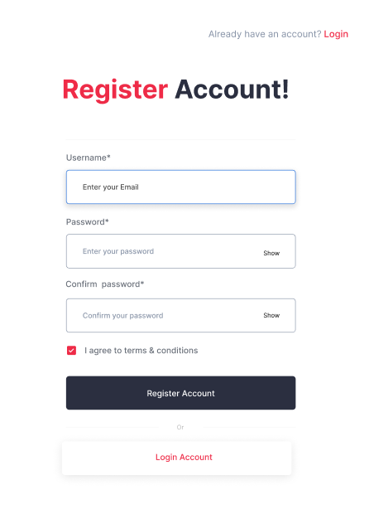
REGISTER PAGE
Validate:
All fields are required (If username/password/confirm
password empty and clicked register => Notice message
require)
On focus => Blur => Notice message require
Username : must be a valid email <...@....>
Password : must be higher than 6 characters
Confirm Password: must be the same with password field
Re-type Password Field => Empty Confirm Password Field
Logic:
Click Login => To Page Login
Click Register and all validations are right =>
Register and go to page login

Slide 10
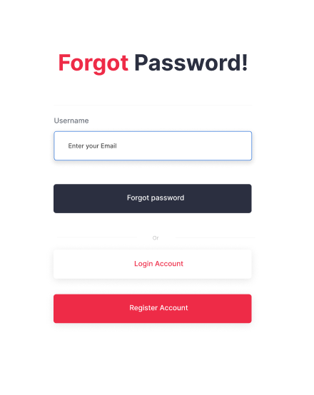

FORGOTPW & CHECK MAIL
Validate:
Field is required
On focus => Blur => Notice message require
Username : must be a valid email <...@....>
Logic:
Click Login => To Page Login
Click Register => To Page Register
Click forget password => To Page Check Your Email

Slide 11
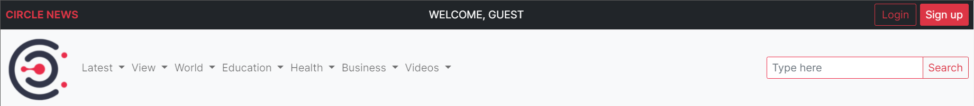
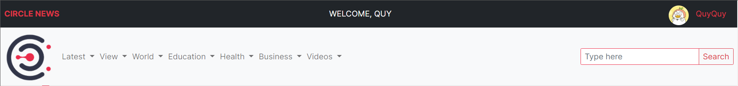
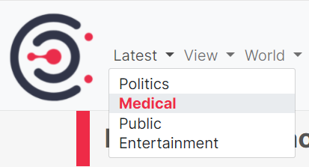
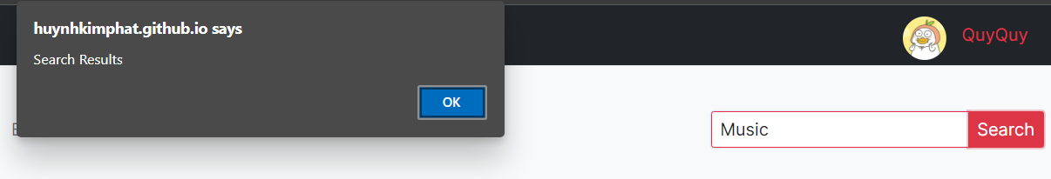
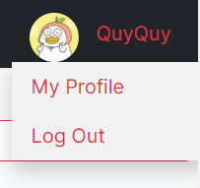
HEADER

Slide 12
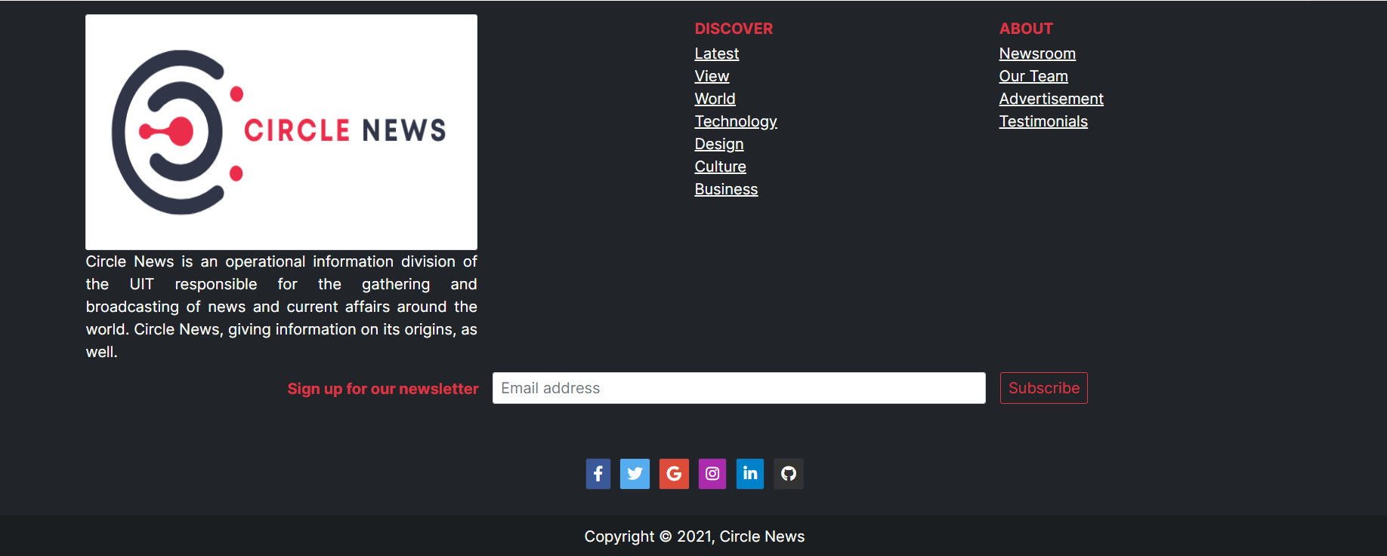
FOOTER

Slide 13

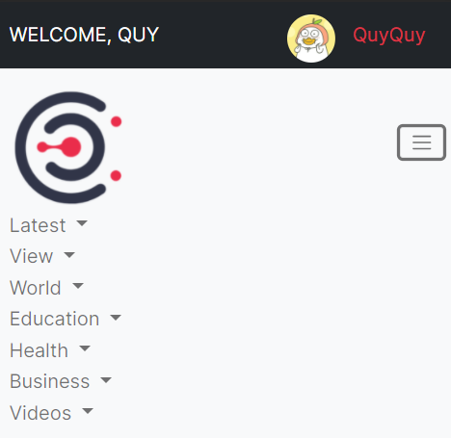
HEADER – FOOTER RESPONSIVE

Slide 14
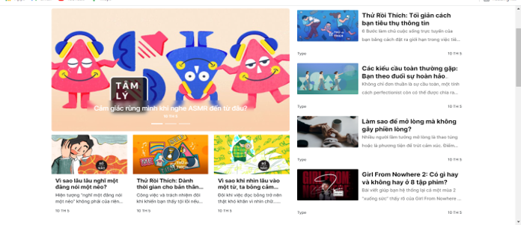
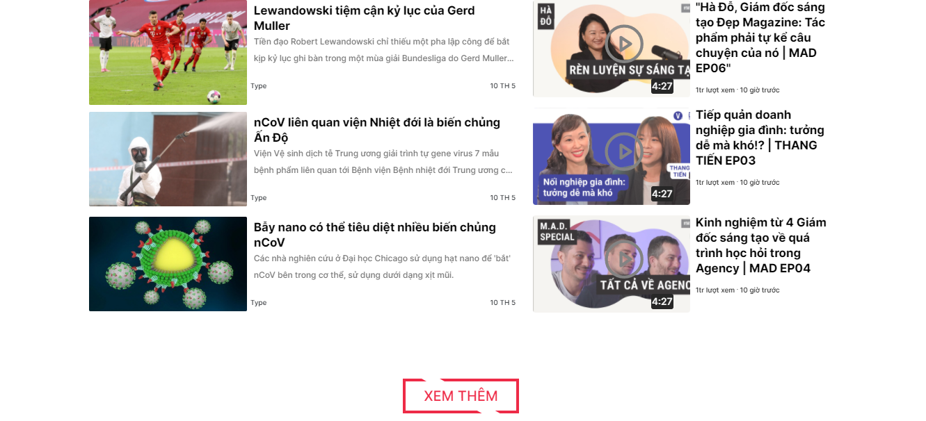
HOMEPAGE
DESCRIPTION
UI:
Like Layout Image
All post component have :image , title , type, a piece of content, time(? hours ago)
Logic:
Carousel : Just Display Top 3 News ( Read Owl Carousel 2 Or Slick Carousel)
Click on post -> Go to page details
Click see more => Display more post

Slide 15
DETAIL
Title
Image, Content
Comment Box
Another post, shared post

Slide 16

Title
Image, Content

Slide 17
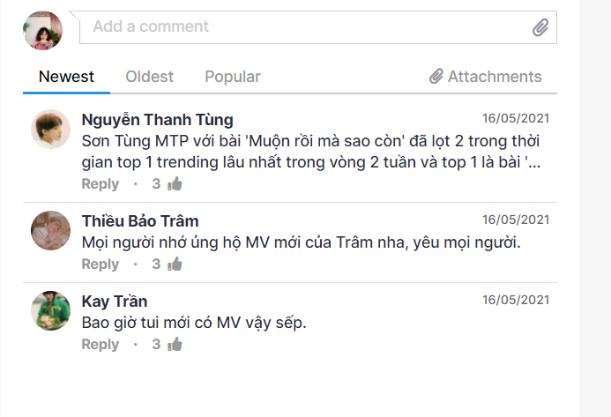
Comment

Slide 18
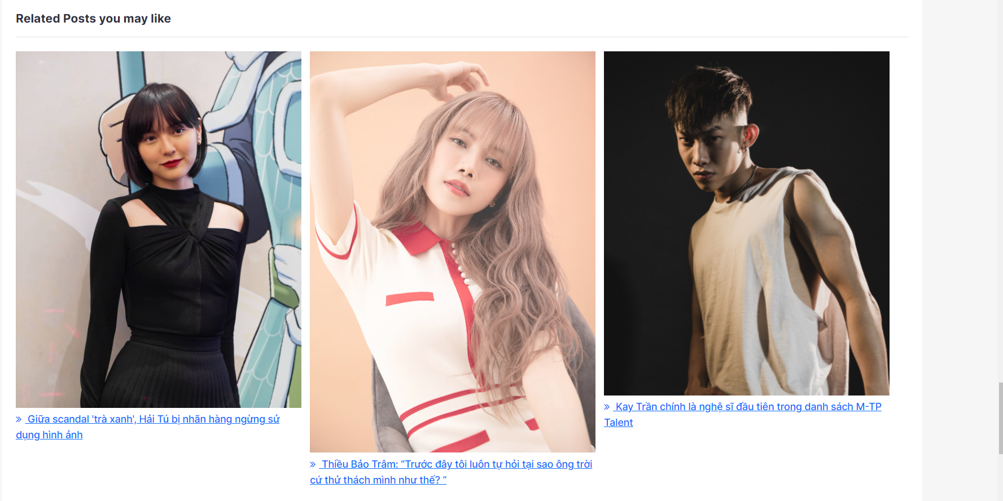
Another post

Slide 19
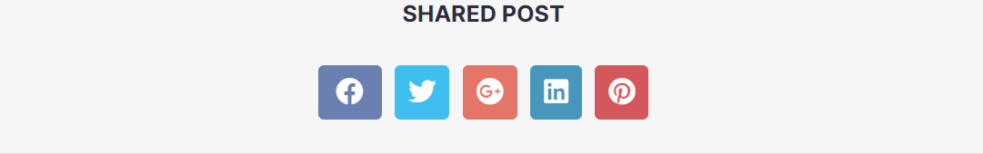
Another post

Slide 20
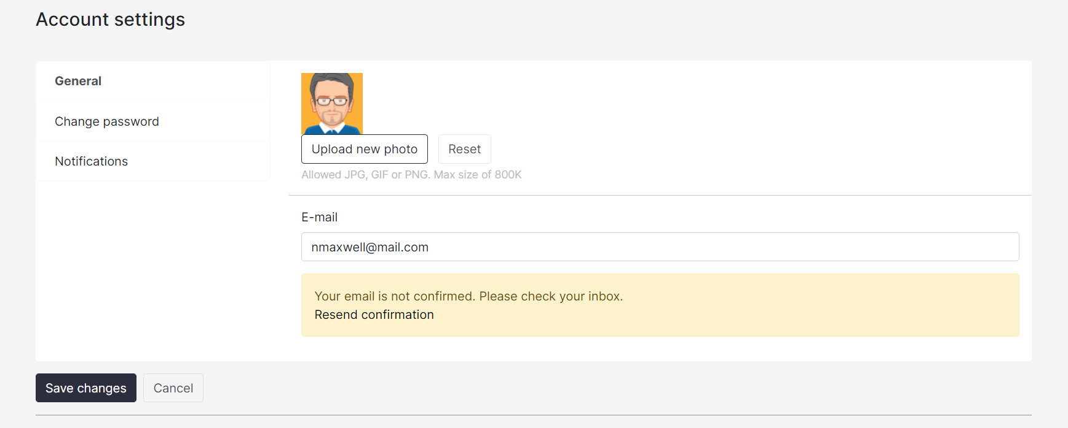
ACCOUNT SETTINGS

Slide 21
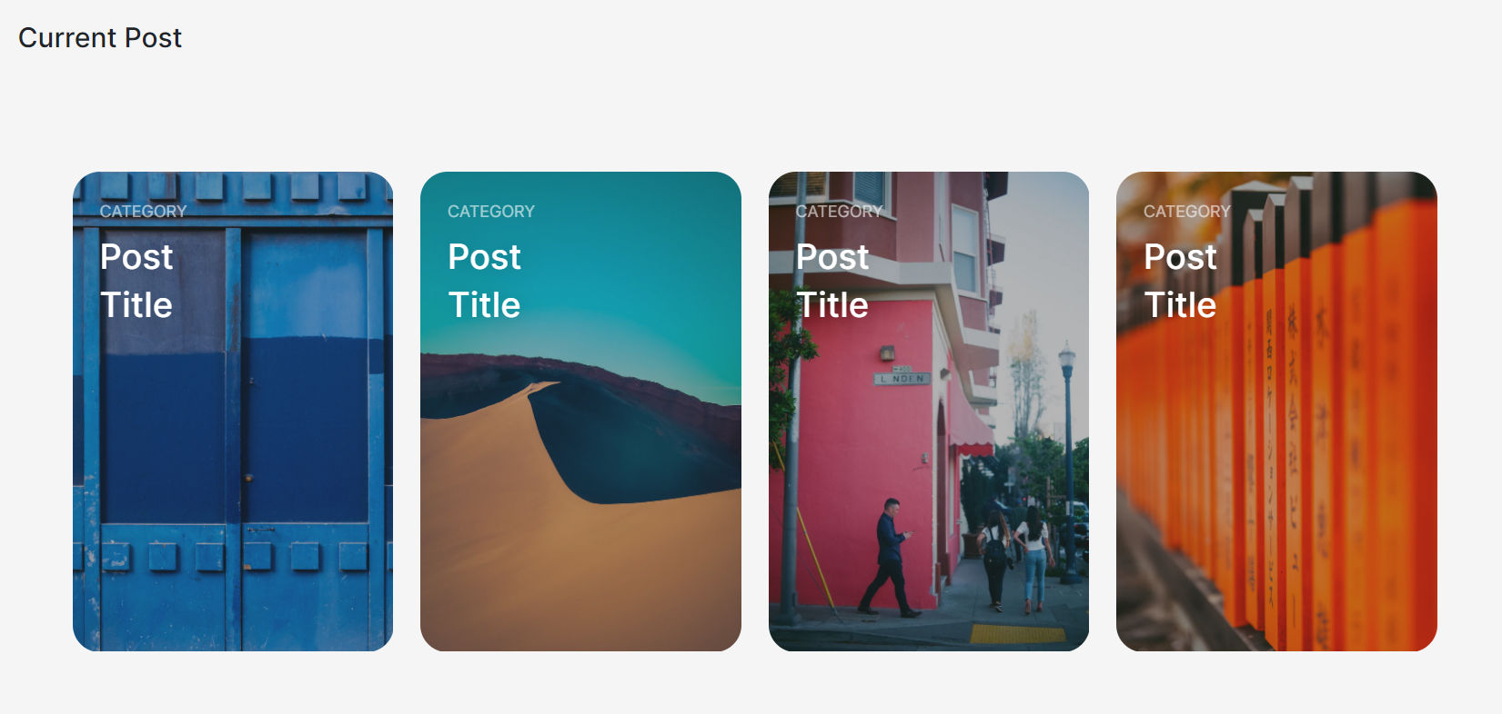
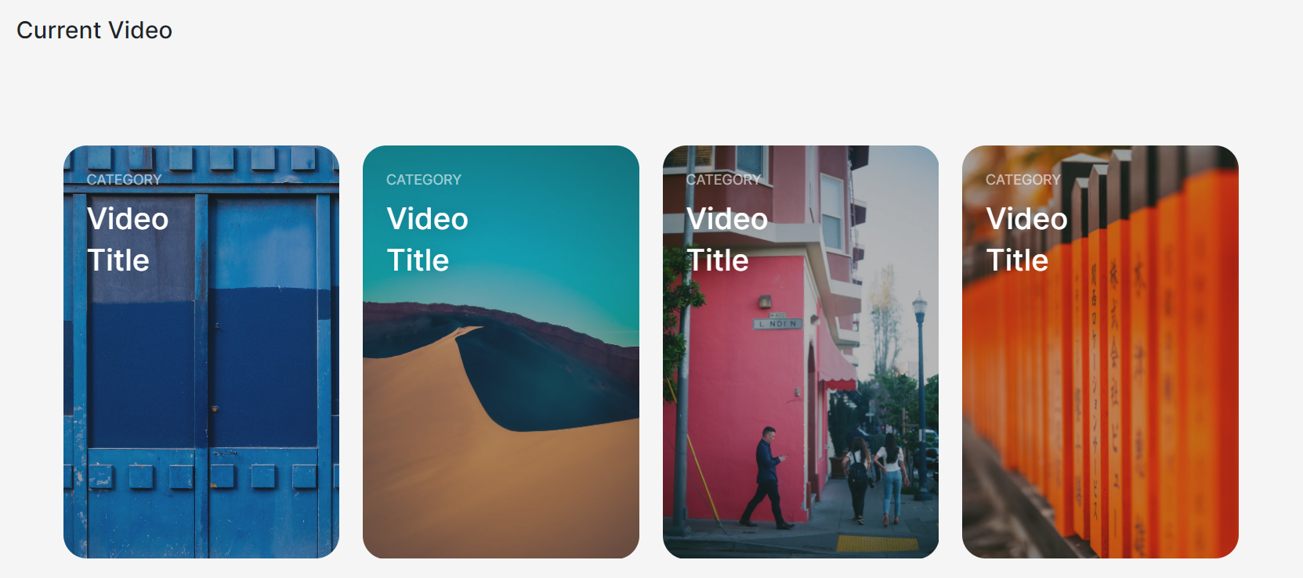
ACCOUNT SETTINGS- CURRENT POST AND VIDEO

Slide 22
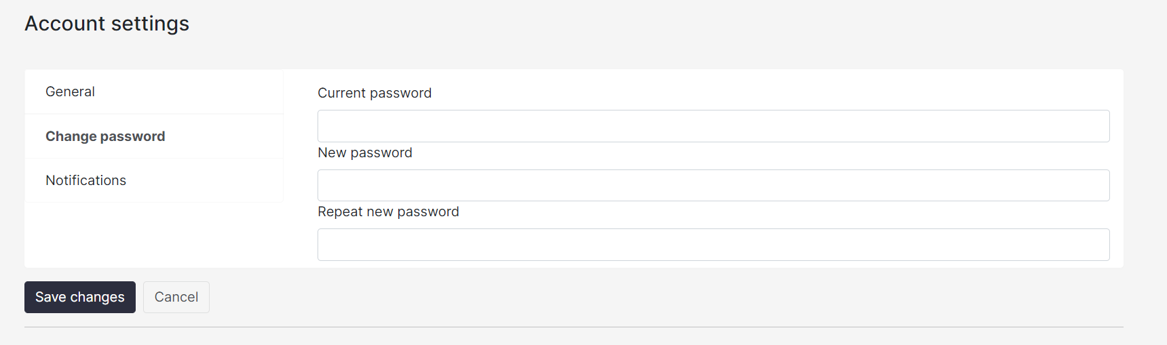
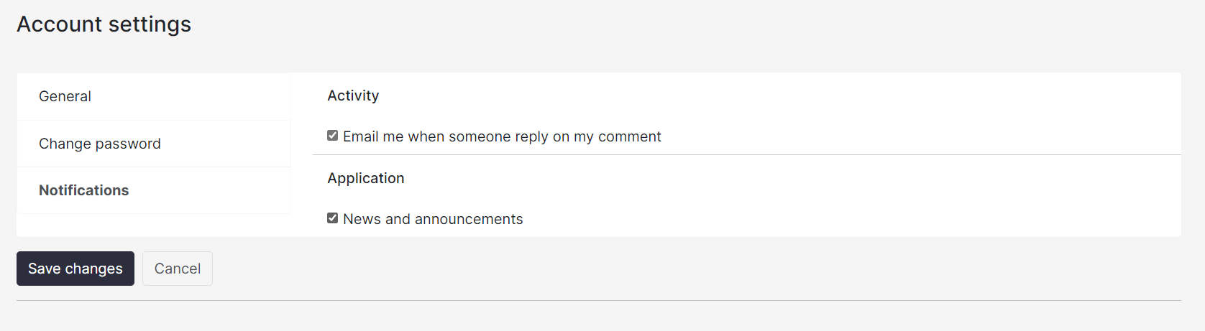
Change password
Notifications

Slide 23
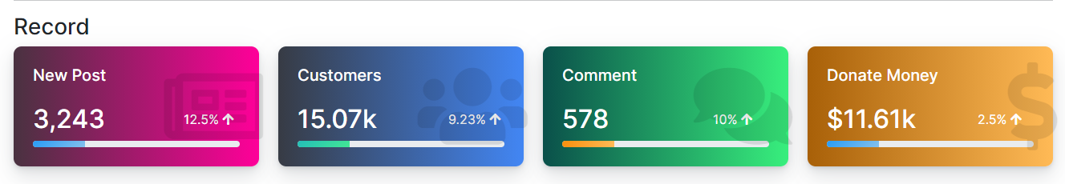
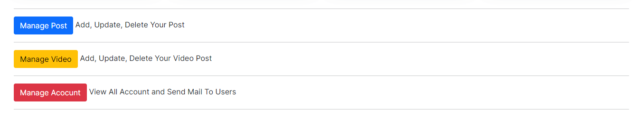
ADMIN UI- MAIN PAGE

Slide 24
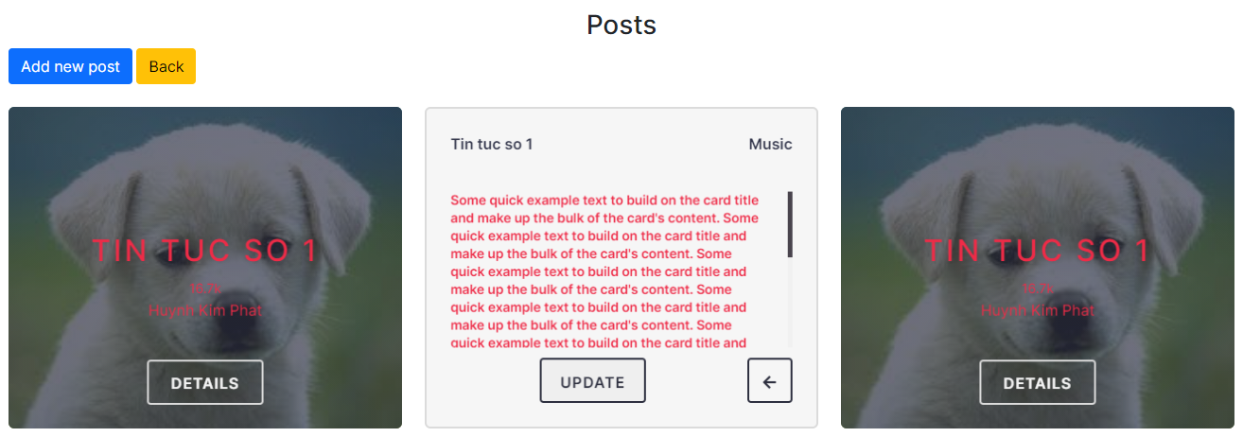
ADMIN UI – MANAGE POST

Slide 25
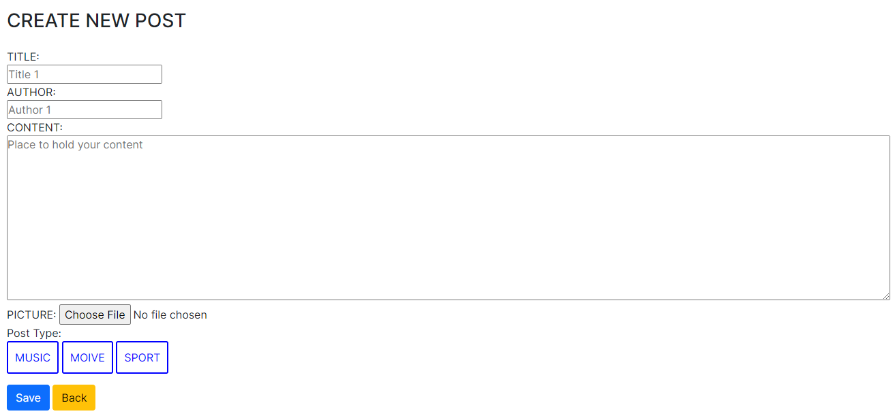
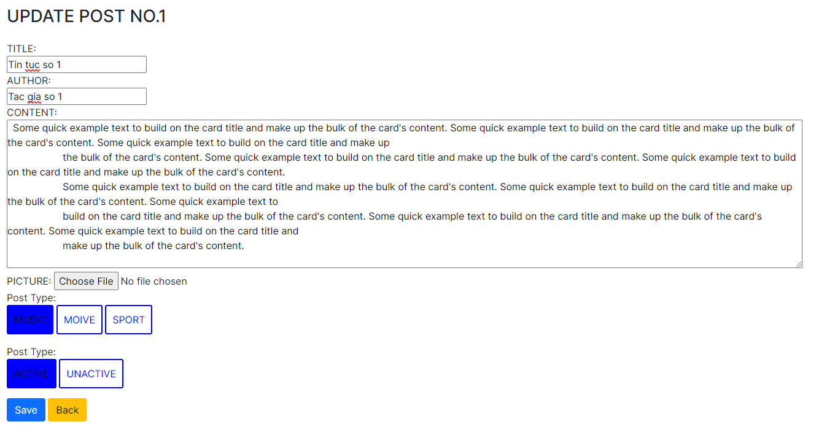
ADMIN UI – CREATE AND UPDATE POST

Slide 26
ADMIN UI – CREATE AND UPDATE POST

Slide 27
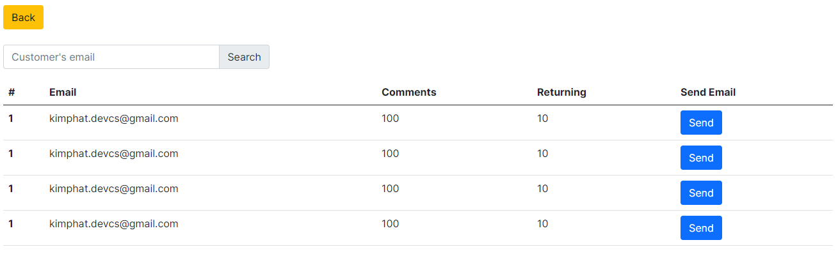
ADMIN UI – CREATE AND UPDATE POST

Slide 28
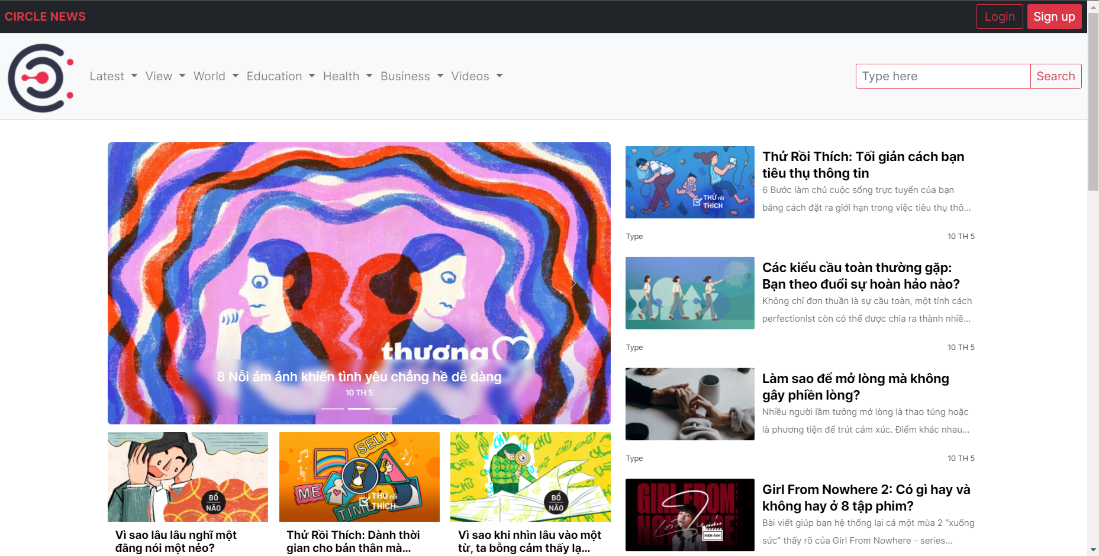
GENERAL INTERFACE

Slide 29
THANKS
Do you have any questions?
https://github.com/Huynhkimphat/UiT_News

